Slide 1

SMART PARKING SYSTEM USING RFID TECHNOLOGY
SACHIN POOJERI – 1MS14IS090
SHUBHAM PAWAR – 1MS15IS418
MD ABDUL AHAD CHANDA – 1MS14IS061
SACHEEN ISHWAR ADAVINAVAR – 1MS14IS089
Supervisor: Dr. Mohan Kumar S.

Slide 2
Introduction
Radio frequency identification is a technology that helps to identify the animate or inanimate through radio waves .
The technologies like RFID readers, RFID writers, RFID barcode scanners, RFID smart sensors and RFID controllers include a wide range of automation technologies.
In this project, The software has been handled for the management , controlling, transaction reporting and operation tasks for parking lots located on various parts of the city . Check-ins and check-outs of the parking-lots will be under control with RFID reader labels and barriers.

Slide 3
Need for system
By this new system, It will be possible to see unmanned, secure, automated parking-lots functioning with RFID technology in the future.
There has been a considerable amount of reduction in transaction costs and decrease in stock shortage with the use of RFID technology in automation.
Drivers will not have to stop at the circulation points and parking tickets will be out of usage during check-ins and check-outs.
Less time, less consumption of fuel, reduce in Pollutions

Slide 4
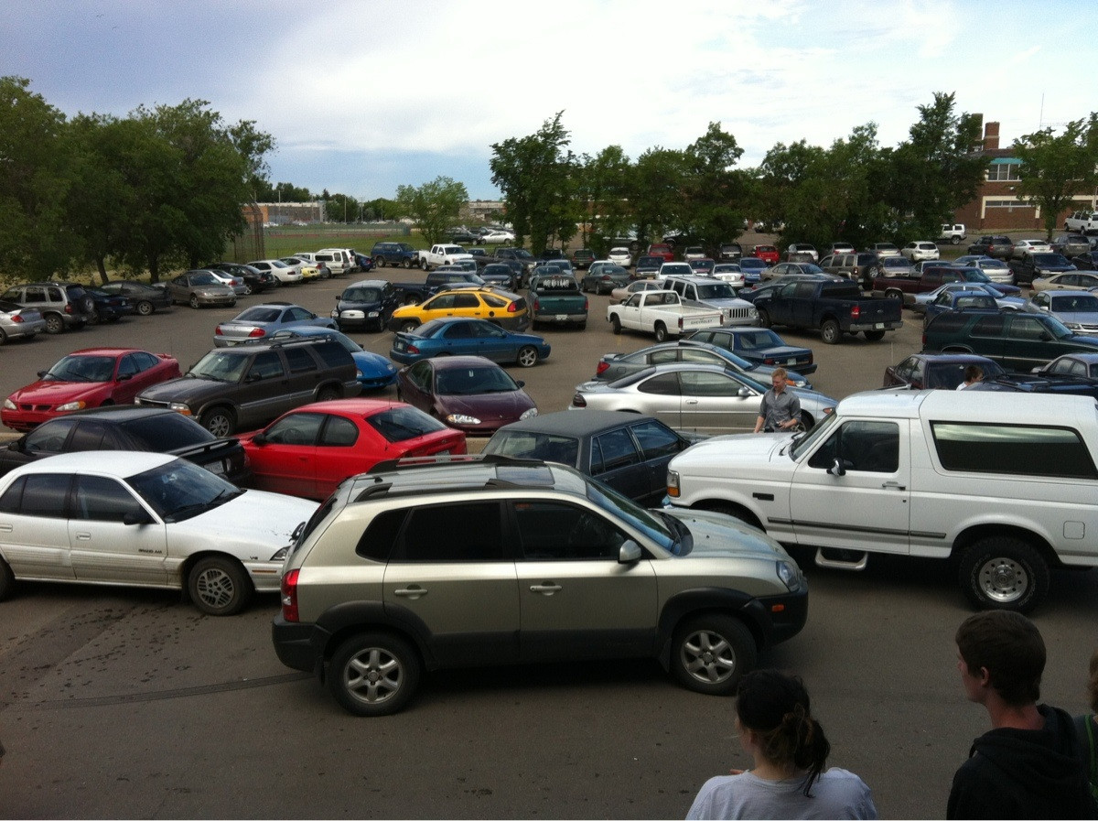
Problem STATEMENT
With increase in the population, number of vehicles increases and due to unmanaged parking system it leads many problems.
In center cities, people faces difficulties as increasing number of vehicles creates congestion, wastage of space , wastage of time, traffic problems, car napping , car vandalism and many other difficulties.

Slide 5
Literature review
S.No | Title/Publications | Authors | Conclusion
1. | Smart Parking Applications Using RFID Technology | Zeydin Pala Nihat Inanc | In this project, it is proven that by utilizing RFID readers and RFID labels with a centralized database system, all the parking-lots in a city could be operated in an economical and fast way. This prototype will provide for automation of the operation and controlling ability for all of the parking-lots in a city by using standardized devices. Compared with traditional barcode identification technology, RFID possesses characteristics; such as reading multiple tags once, reading/writing many times, and so on. Implementation of the RFID technology, in an existing parking lot access control system, has given benefits to all interest parts (the Parking Operator, parking place users and parking collectors). People using parking place are spending much less time waiting in line to buy the tickets for the on-street parking and much less time waiting at the entry and exit barriers of a parking lot or garage.

Slide 6
S.No | Title/Publications | Authors | Conclusion
2. . | Smart Parking Guidance, Monitoring and Reservations | Amir O. Kotb Yao-chun Shen Yi Huang

Slide 7
S.No | Title/Publication | Authors | Conclusion
3. | RFID-based efficient method for parking slot car detection | Petar Šolić Ivan Marasović Maria Laura Stefanizzi

Slide 8
S.No | Title/Publications | Authors | Conclusions
4

Slide 9
Proposed system and Methodology
Check-in Point
Check-out Point
Read Vehicle ID
Read Vehicle ID
Is the vehicle registered?
Do not open the gate
Is the vehicle registered?
Register the vehicle info to the Database
Did the vehicle check -in?
Did the vehicle check -in?
Do not open the gate
Database
Database
Read vehicle info
Read vehicle info
Store check-in info
Update check-out info
Open the gate
Close the gate
Open the gate
Close the gate

Slide 10
objectives
The main objective is to make the process auditable and secure.
RFID allows the wireless storage and automatic retrieval of data. It provides a significant improvement over not only conventional identification, tracking, and stocking of objects, but over the barcode system as well.
The proposed design is economically viable and cheap.
Smart system that parks a number of vehicles with the least space possible with less time and highly efficient.

Slide 11
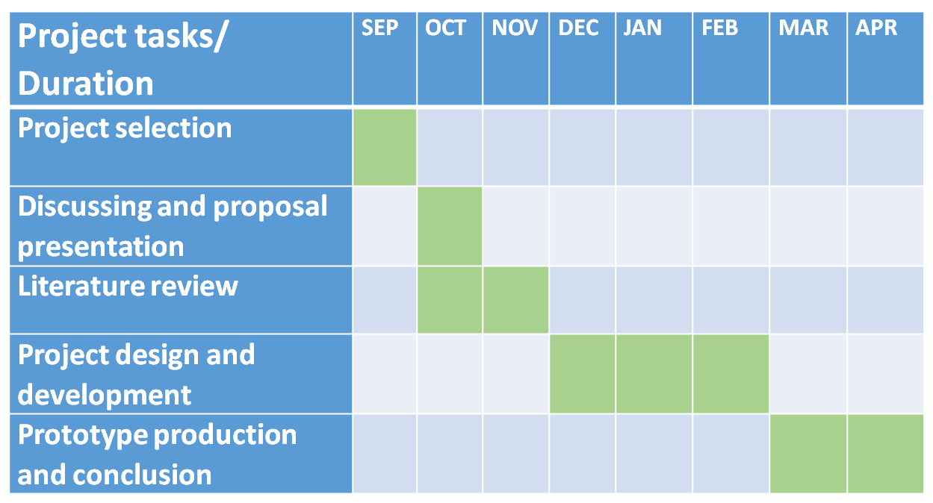
Project Management

Slide 12
Expected outcome
This system will provide a smooth traffic flow within the parking-lot thus preventing the emission gas formation
Instead of parking vehicles on streets and putting them into risk, drivers will be able to leave their vehicles e parking-lots with contentment.
Vehicle owners will not have to make payments upon every check-out. .
vehicle accumulations on various places will be avoided and new precautions will be taken according to the demands.

Slide 13
References
Reference websites:
http://whitepapers.zdnet.co.uk /0,1000000651,260090942p,00.html
http://supplychain.ittoolbox.com /blogs /featuredentry.asp
Reference books:
Anonymous, 2005. Electronic tolling technology & implementation. Richmond
Arnott, R., Rowse, J., 1999. Modeling parking, Journal of Urban Economics 45, pp. 97–124.
Banks, J., Pachano, M., Thompson, T., Hanny, D., 2007. RFID Applied. 299. John Wiley & Sons.

Slide 14
THANK YOU

